Slide 1
NGS (next generation sequencing) generates short reads, and usually the short reads need to be mapped (aligned) to a reference sequence. For genome sequencing, this is a reference genome. Why does the technology generate short reads?

Slide 2
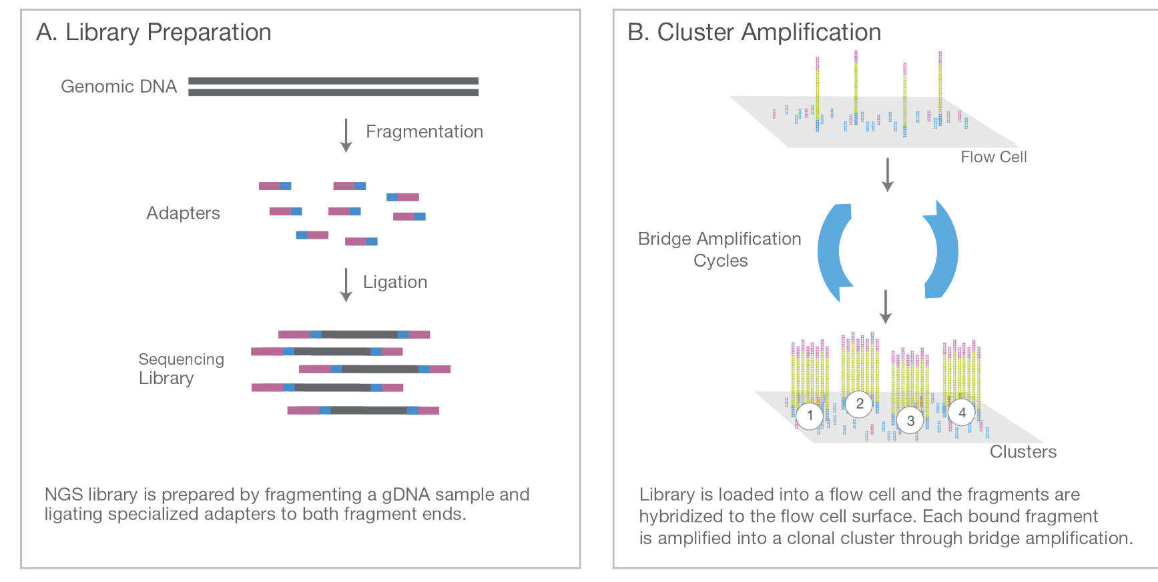
https://sapac.illumina.com/content/dam/illumina-marketing/documents/products/illumina_sequencing_introduction.pdf

Slide 3
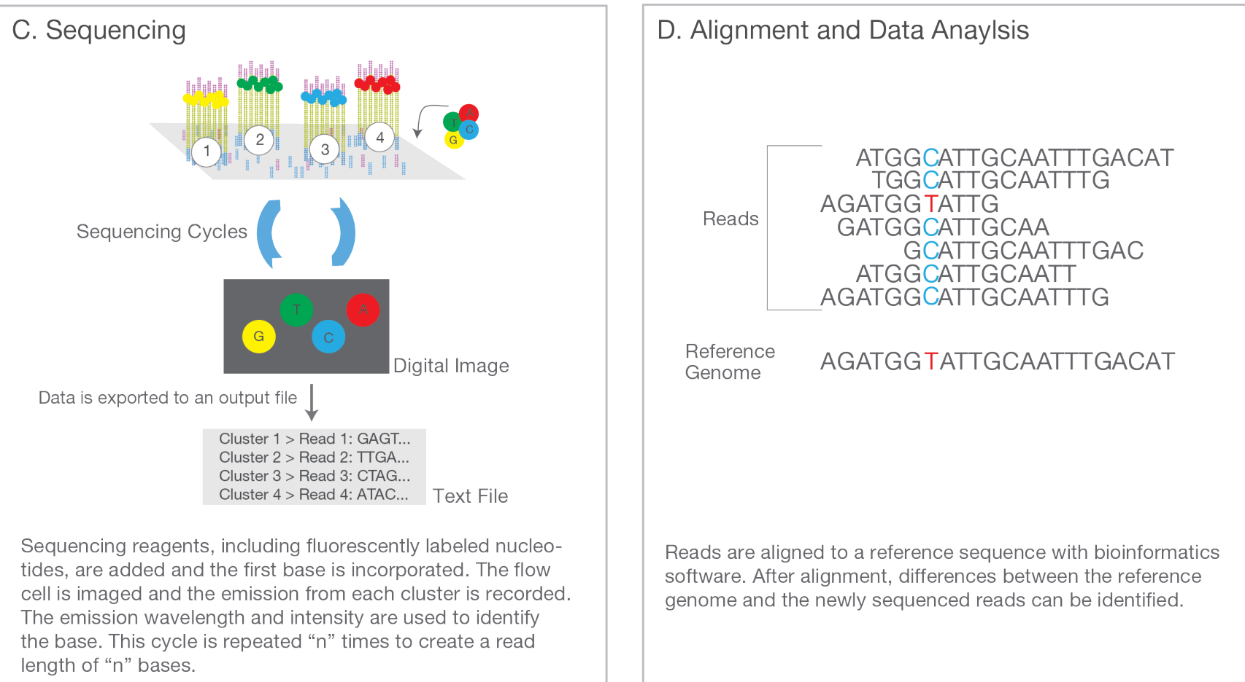
https://sapac.illumina.com/content/dam/illumina-marketing/documents/products/illumina_sequencing_introduction.pdf

Slide 4
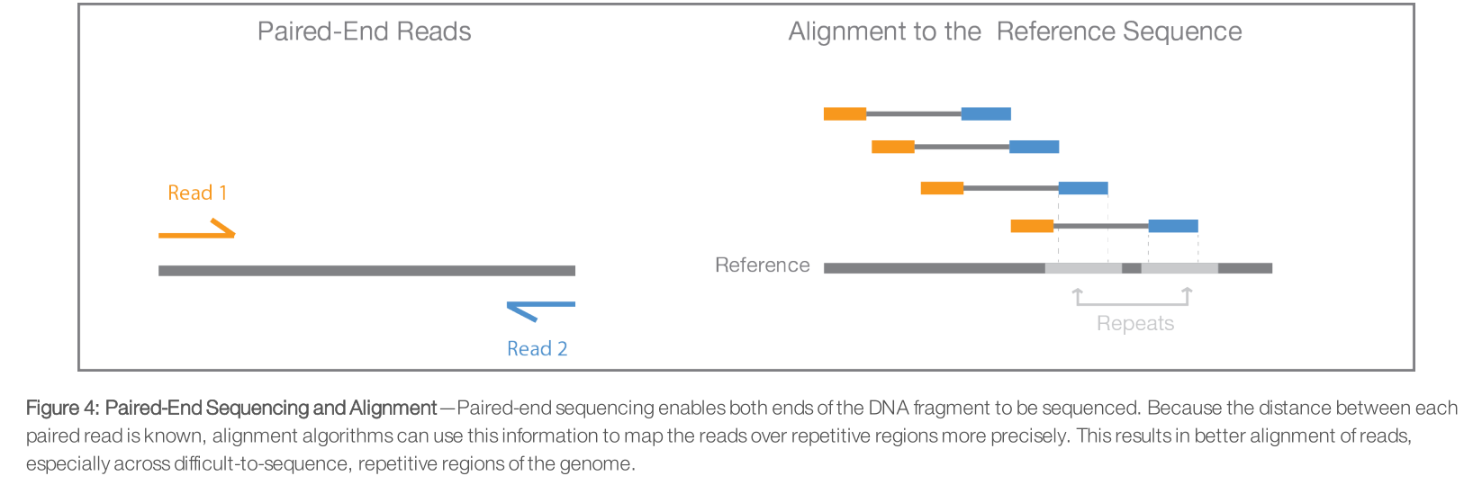
https://sapac.illumina.com/content/dam/illumina-marketing/documents/products/illumina_sequencing_introduction.pdf
Gritty details for reference, do not need to know: https://seekdeep.brown.edu/illumina_paired_info.html

Slide 5
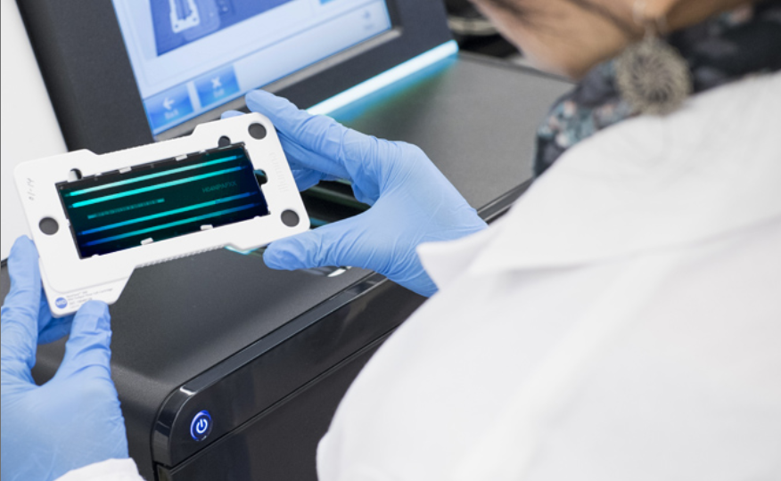
Flow cell

Slide 6
5 minutes of much more detail from Illumina
https://youtu.be/fCd6B5HRaZ8
What you need to know
DNA (or cDNA) is fragmented
You can optionally select fragments (e.g. just from exons) by hybridization or PCR amplification)
Various adapters and index sequences are added on to the ends of the fragments
Illumina generates reads from both ends (“paired reads”) or just one end
Sometimes, if the fragments are short, paired reads overlap, or reads capture adapter or index sequence at the far end of the fragments
Reading is done by incorporating fluorescently labelled nucleotides
For most applications you have to map (align) the short reads to a reference; this could be a genome or a transcriptome (= the set of all transcripts in an organism)

Slide 7
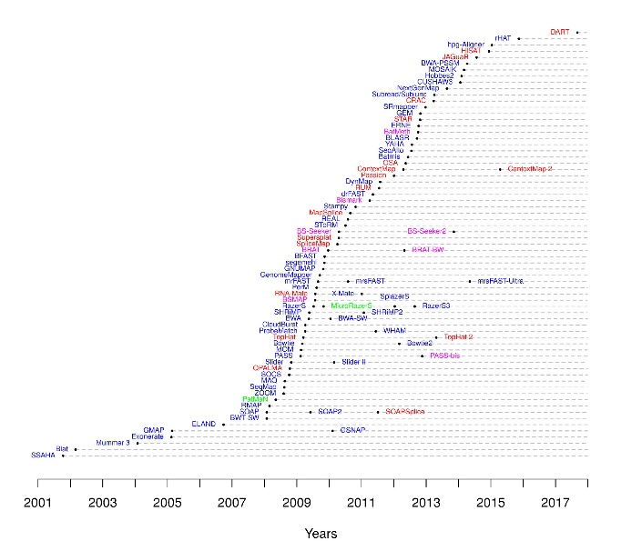
Short read mappers only a few in wide use BWA-MEM TOPHAT2, STAR2 ELAND (from Illumina) and a few others
(Original URL for this image is dead, but see
https://en.wikipedia.org/wiki/List_of_sequence_alignment_software#Short-read_sequence_alignment)
Notes:
Dna blue, RNA red, miRNA green, bisulfite purple

Slide 8
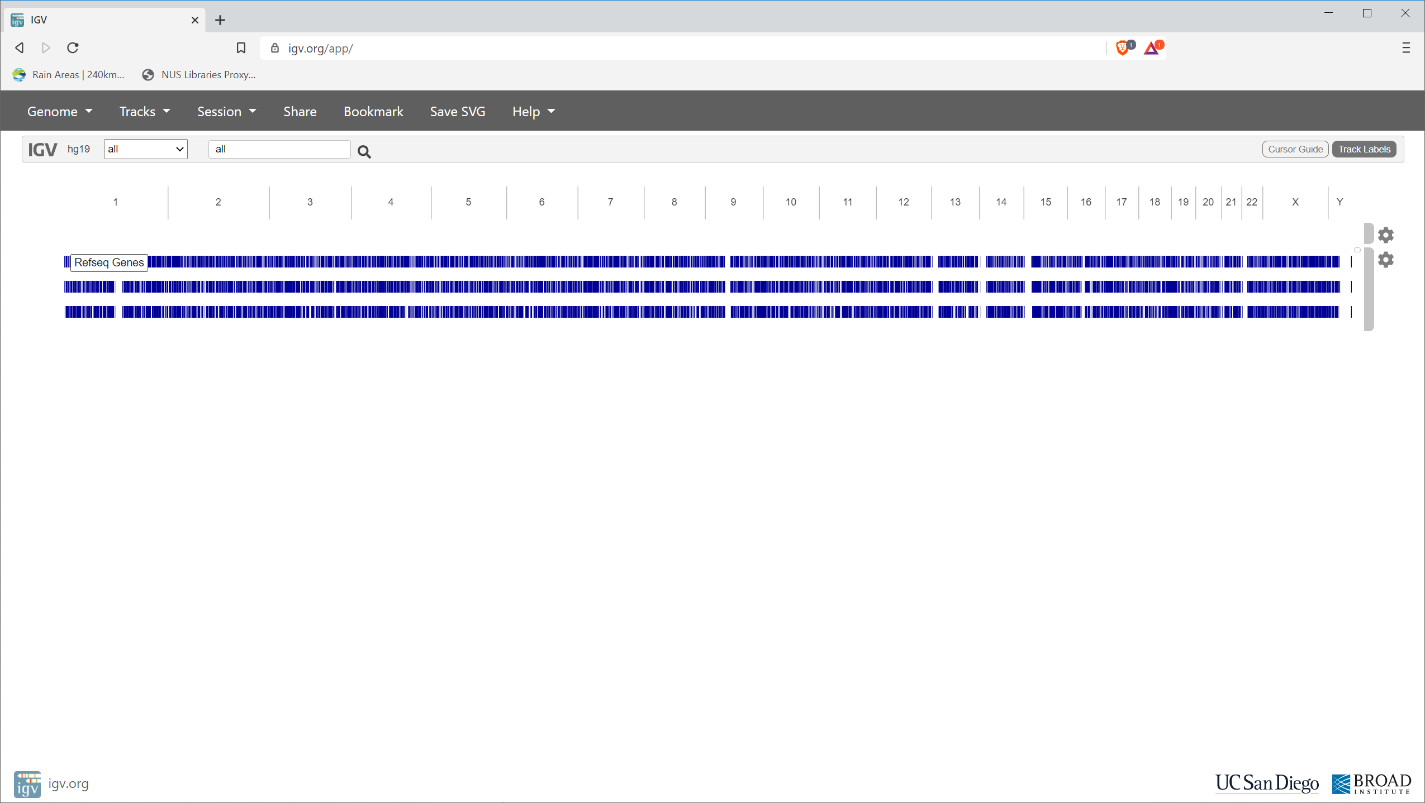
IGV (genome assembly browser)
https://igv.org/app

Slide 9
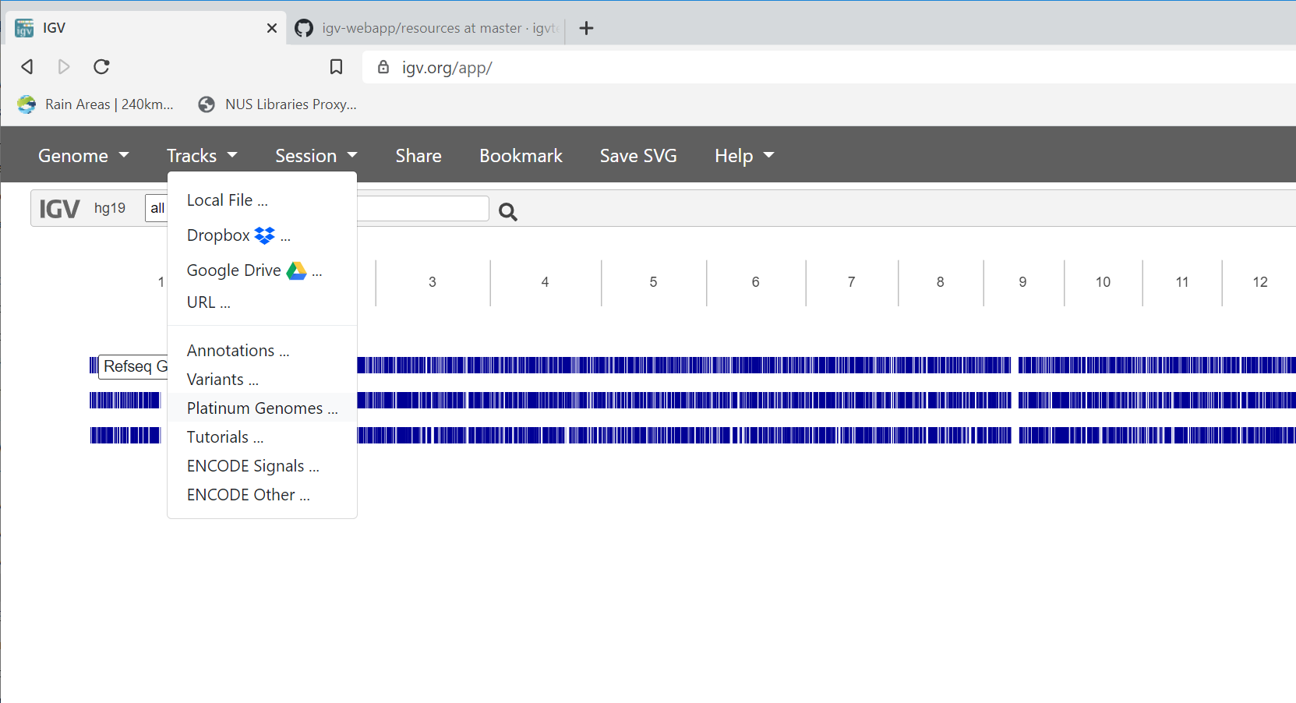

Slide 10
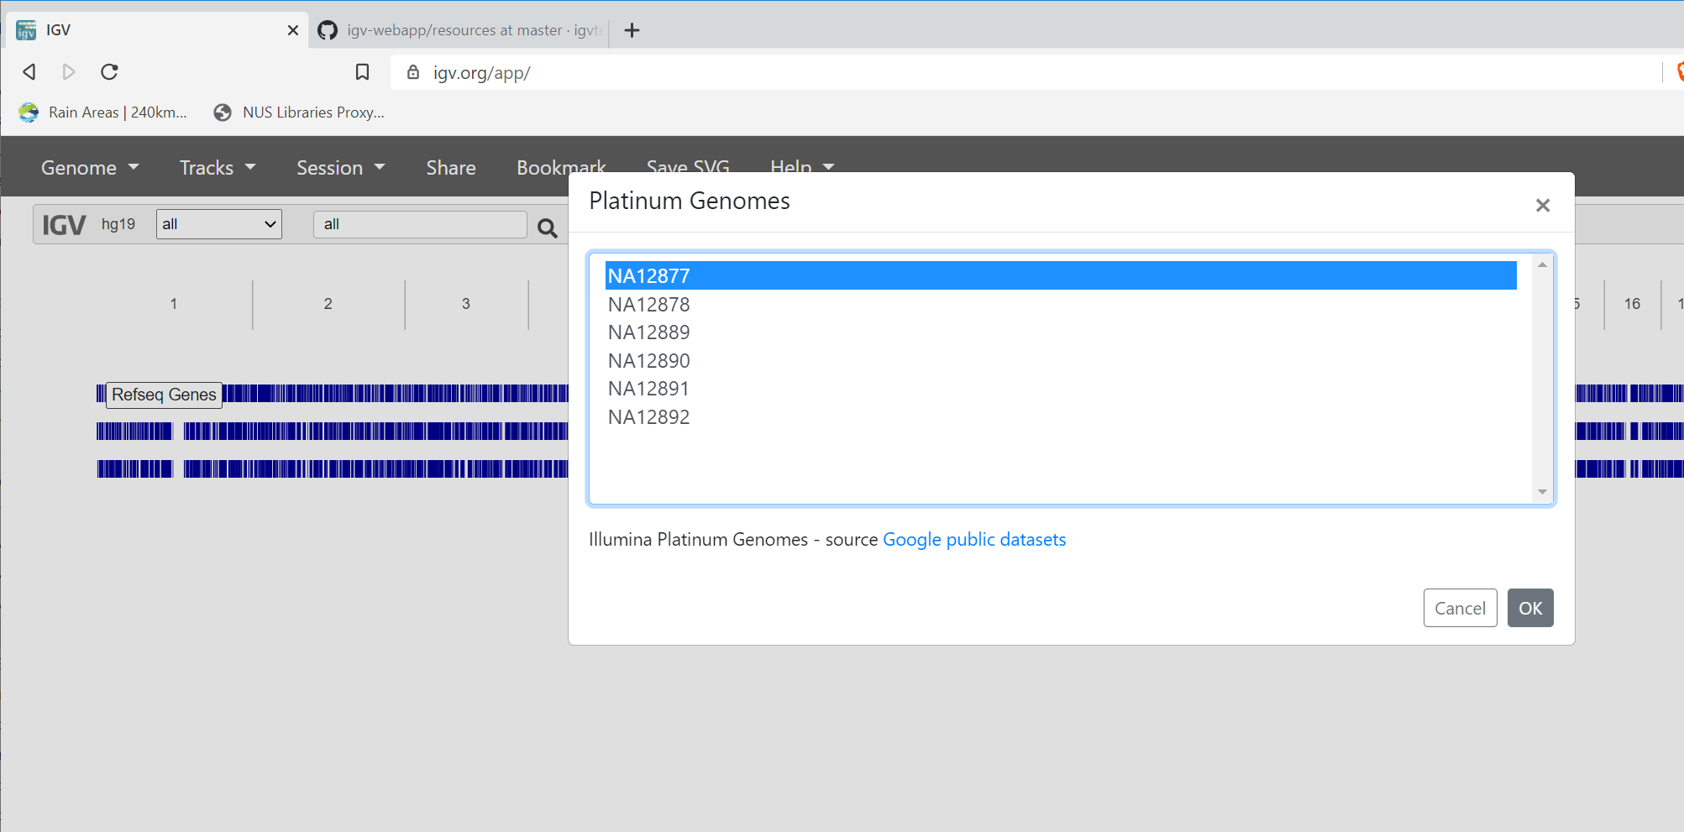

Slide 11
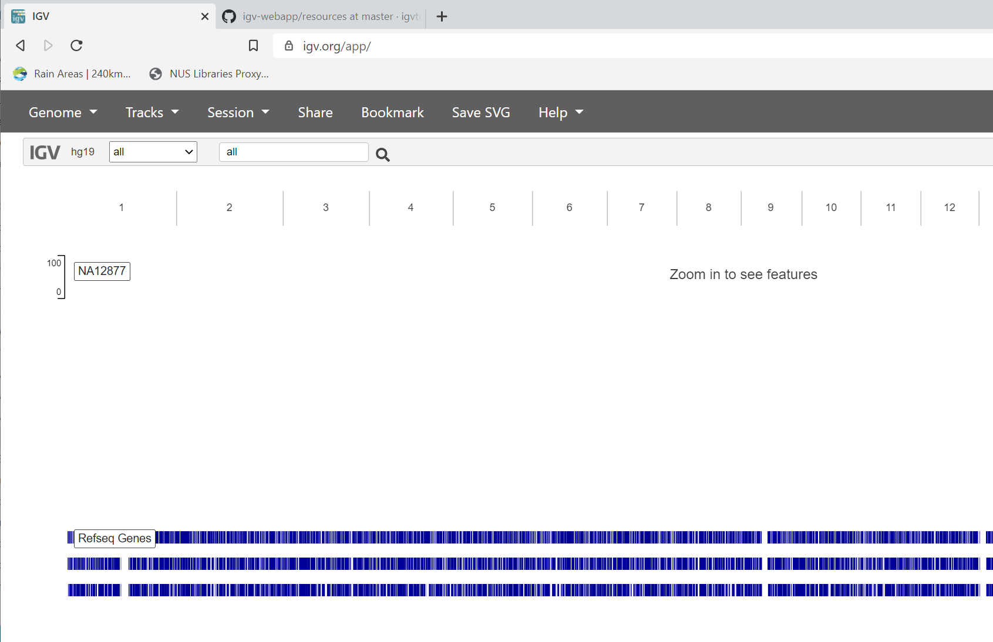
Sample ID
NA12877

Slide 12
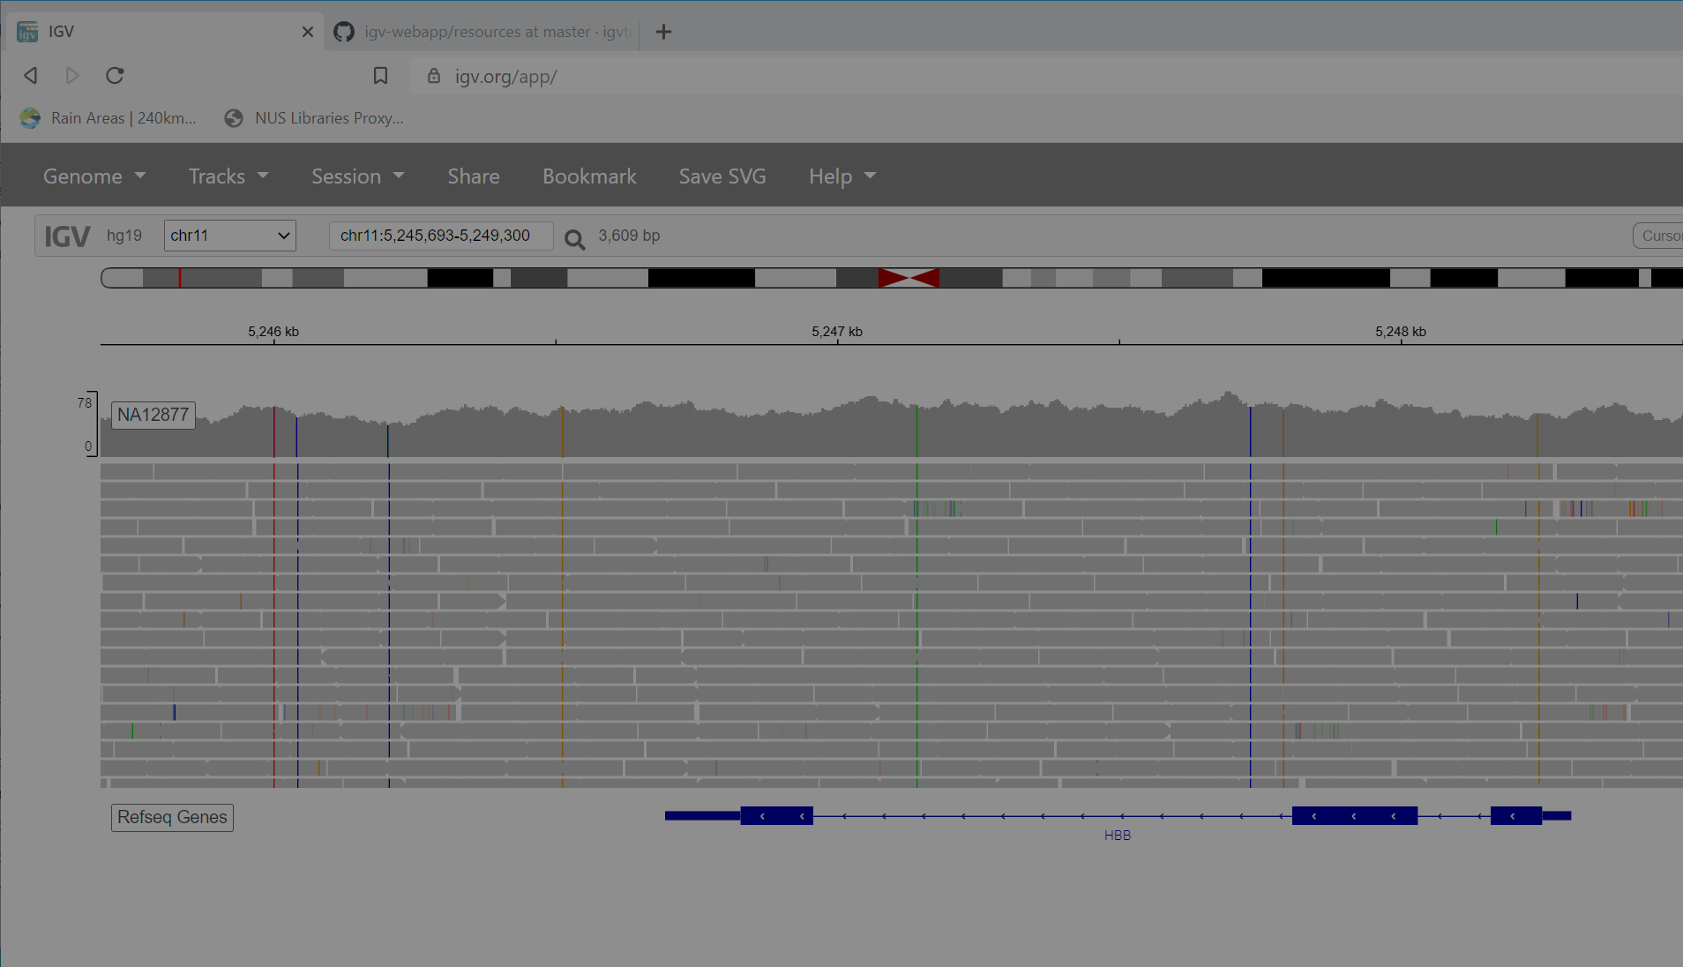
Chromosome 11 cartoon with cytobands
Centromere location
p arm
q arm
Location (on Chr 11)
Read depth plot
Reads
5’ (5 prime) UTR (untranslated region)
3’ (3 prime) UTR (untranslated region)
HBB (haemoglobin B) gene 3 exons
“fishbones” indicate direction of transcription

Slide 13
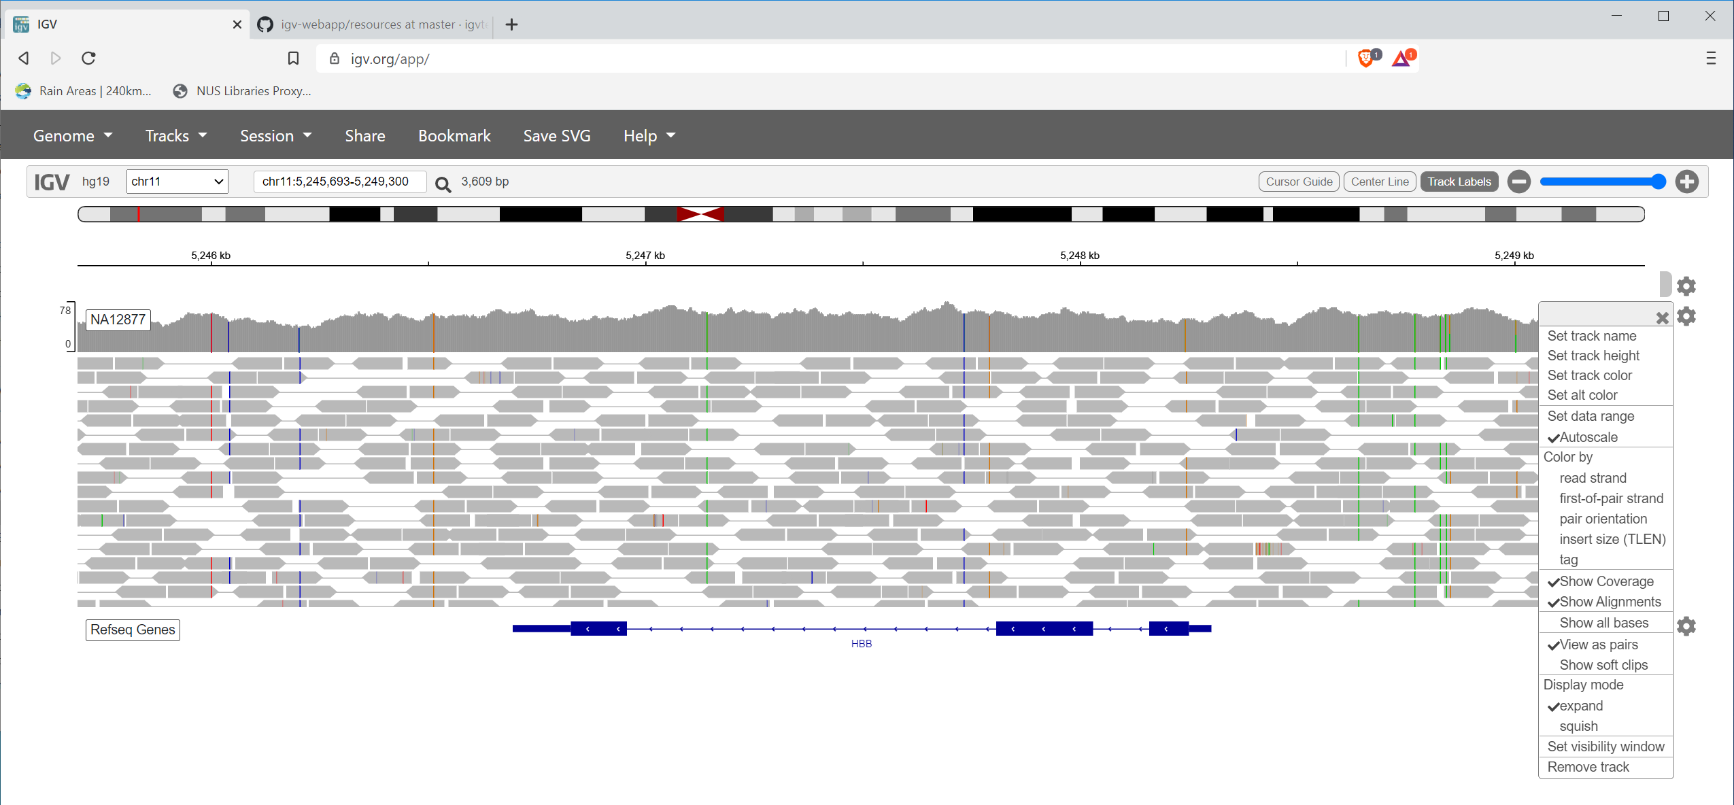

Slide 14
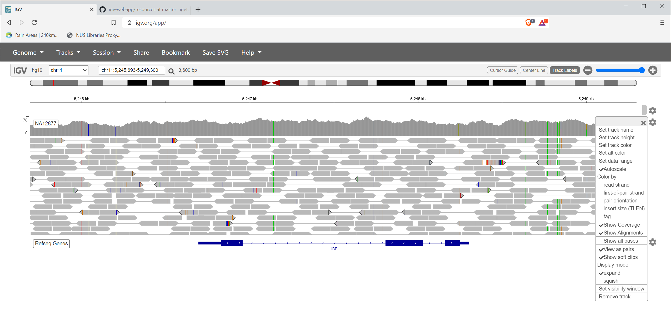

Slide 15
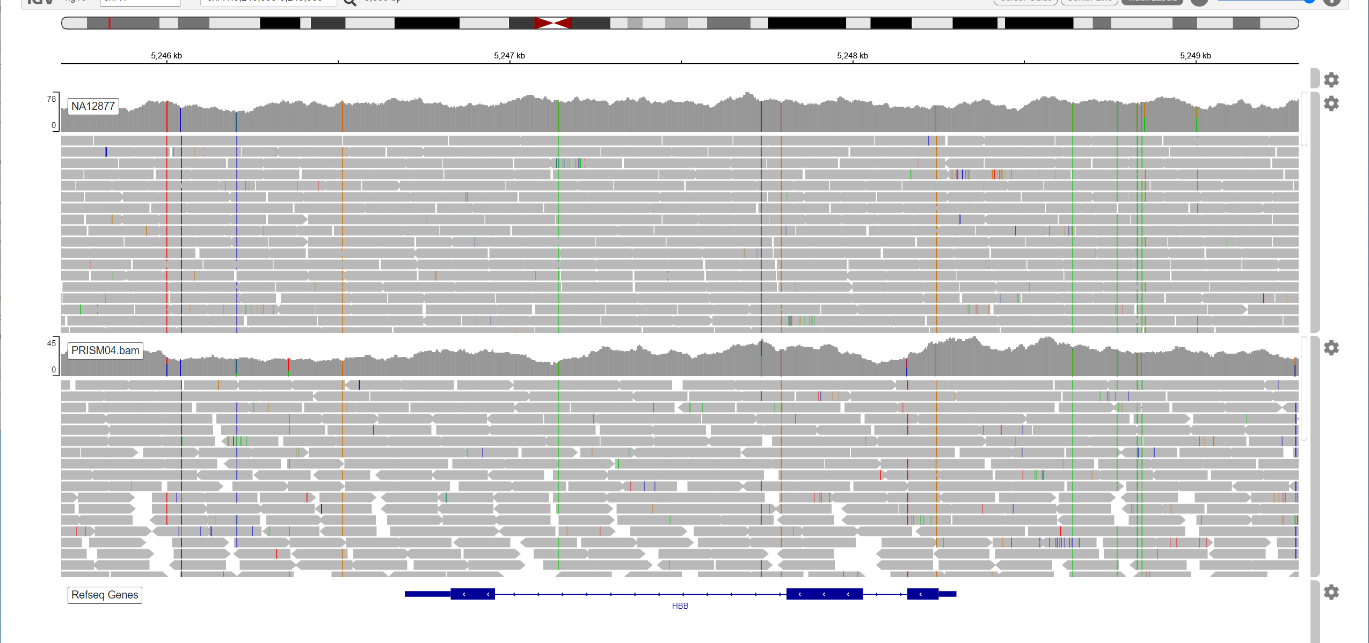

Slide 16
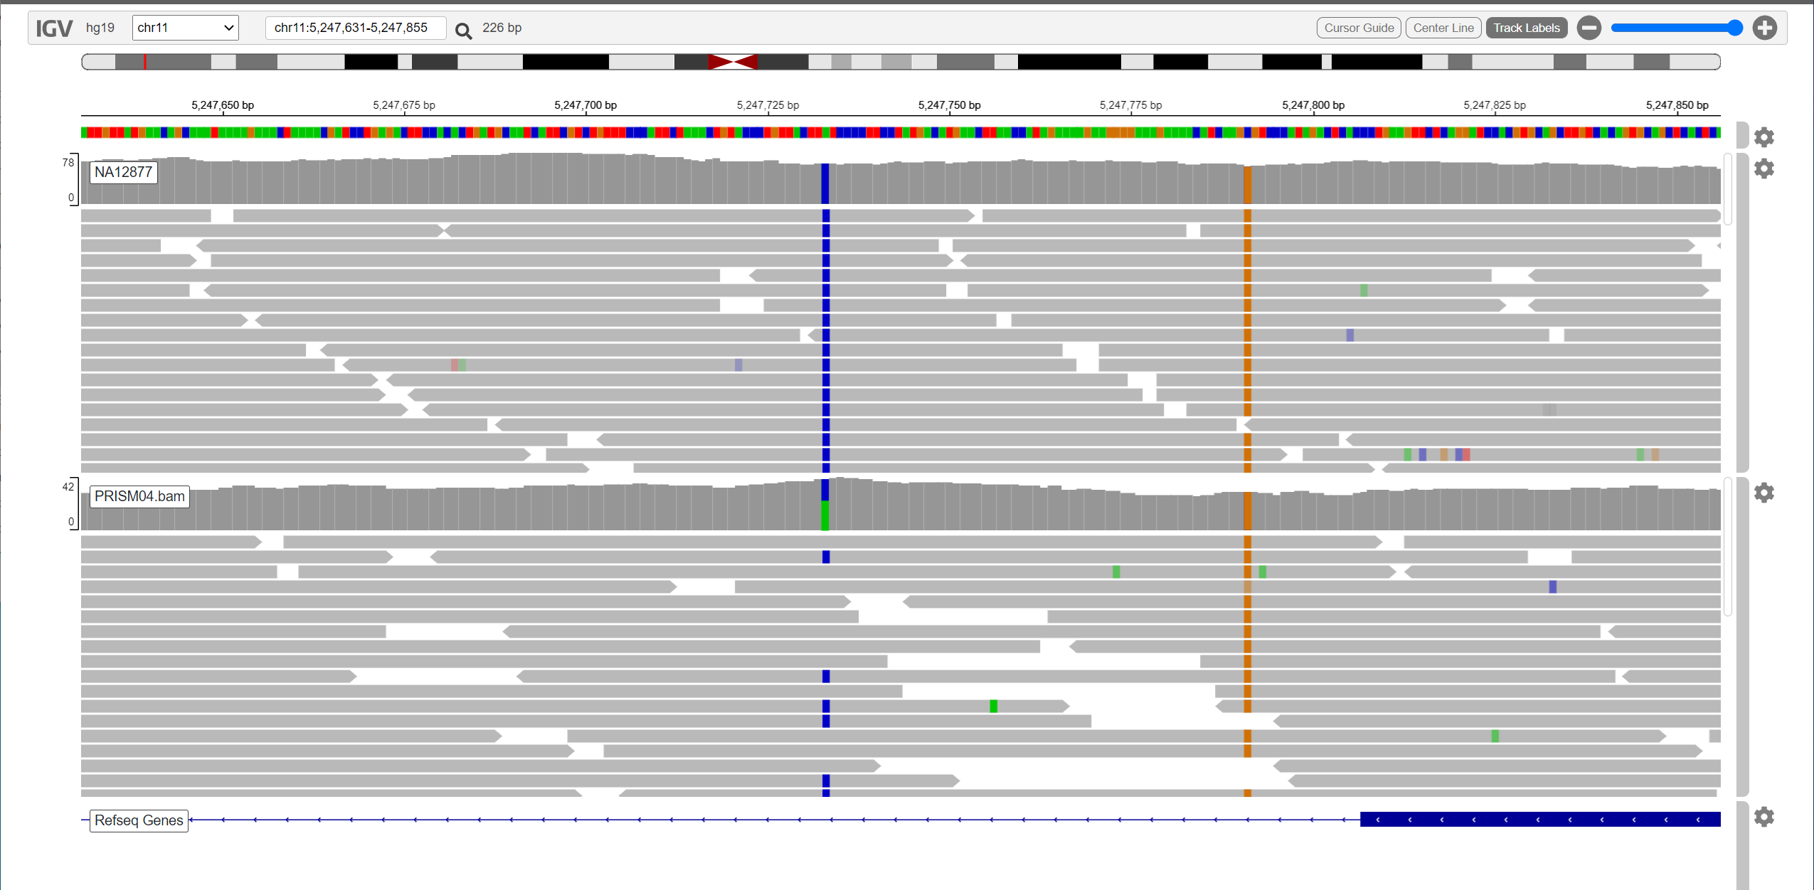

Slide 17
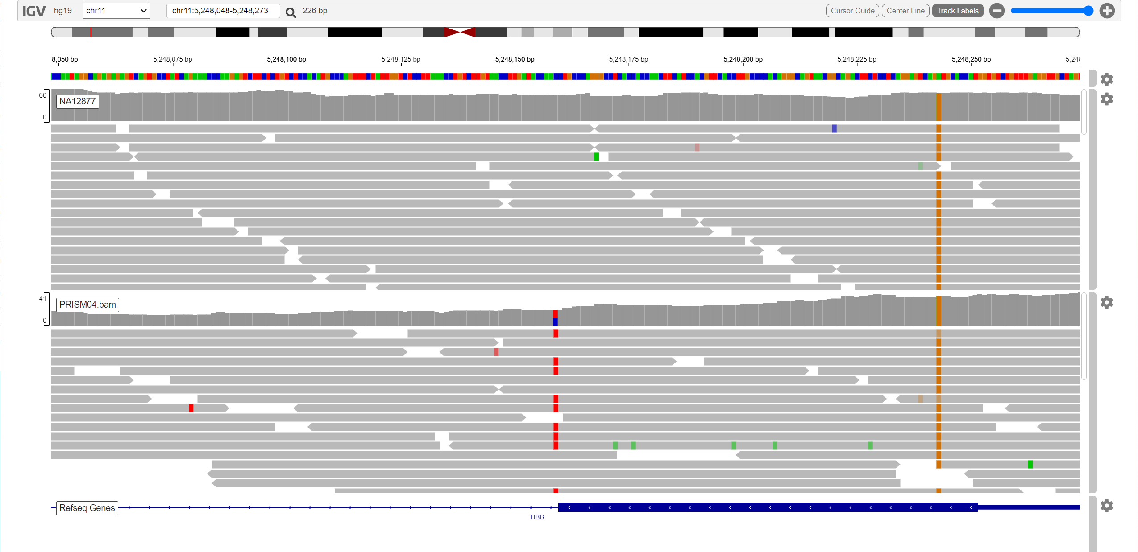

Slide 18
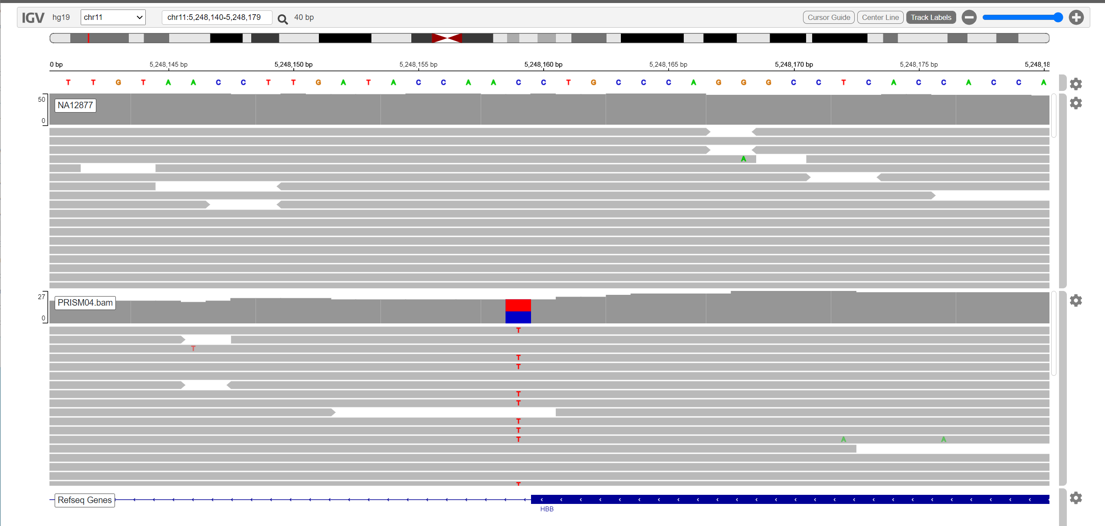
Heterozygous mutation at 3’ splice site of intron 2 of HBB (beta haemoglobin), “beta-thalassemia trait”
Sequence at splice sites very conserved: 5’ end of intron usually 5’-GT-3’, 3’ end is 5’-AG-3’; this variant takes
3’-TG-5’ → 3’-TA-5’ 5’-AC-3’ → 5’-AT-3’

Slide 19
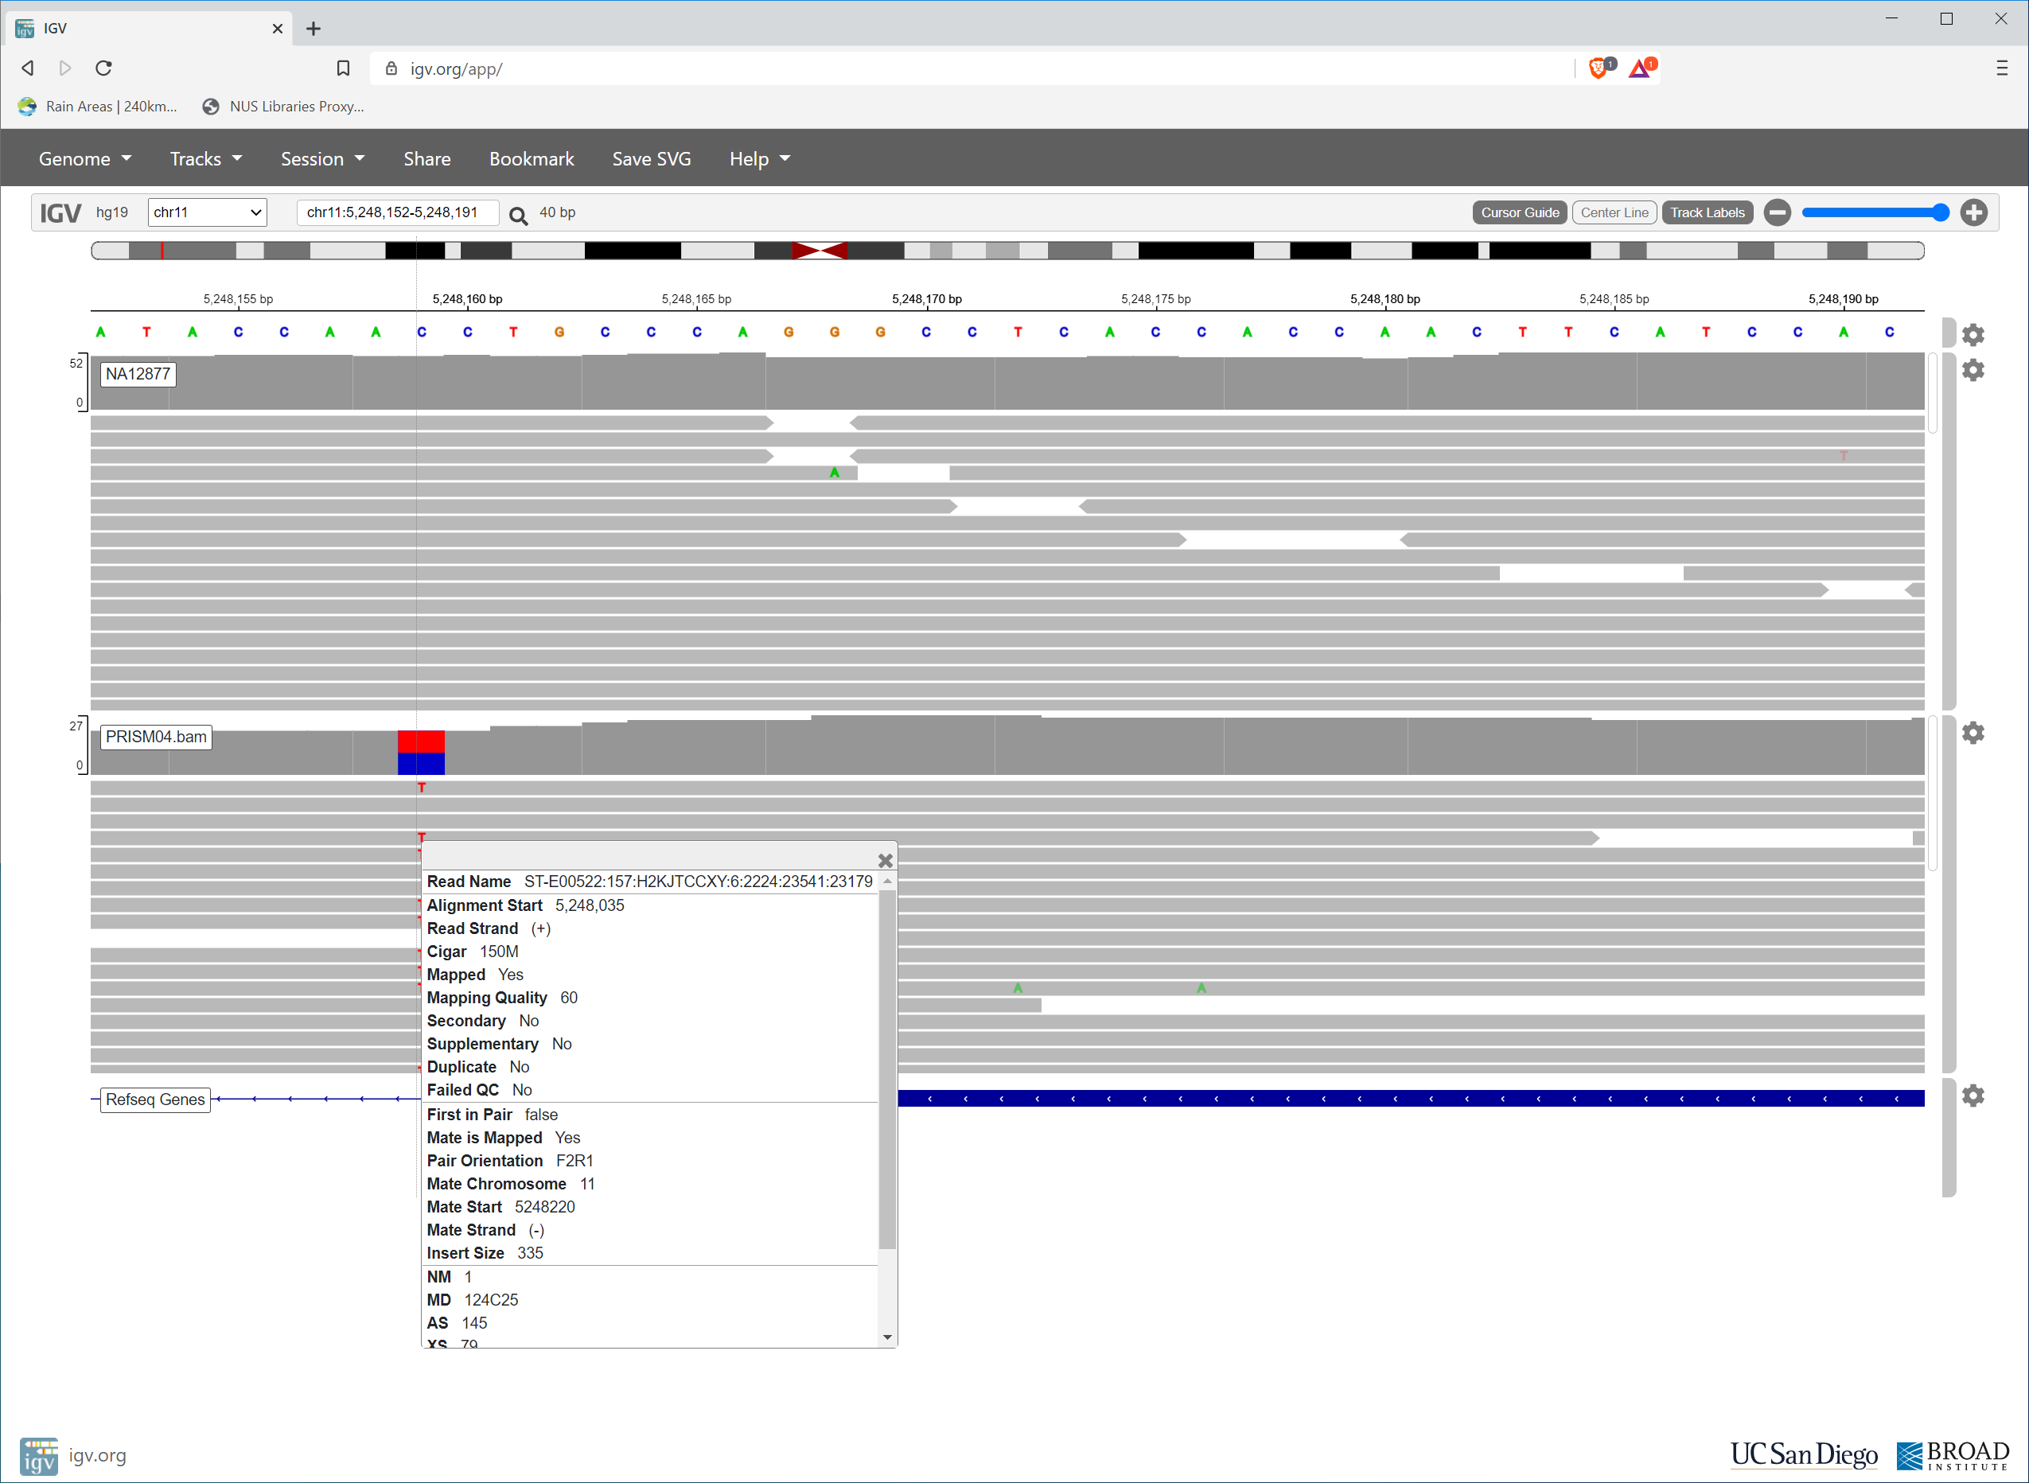
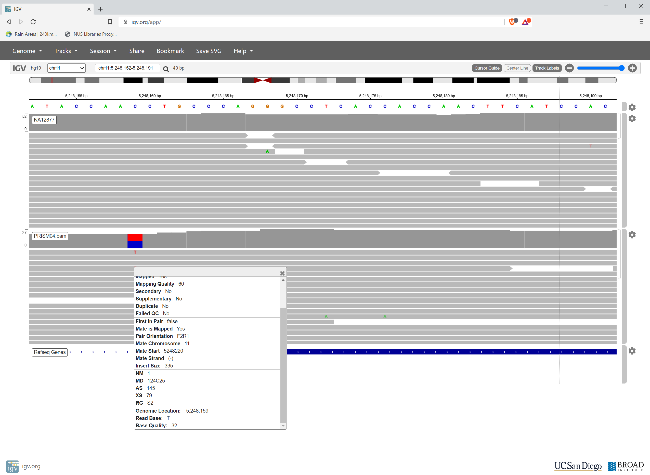
Info on one read and one base in that read
High base quality

Slide 20
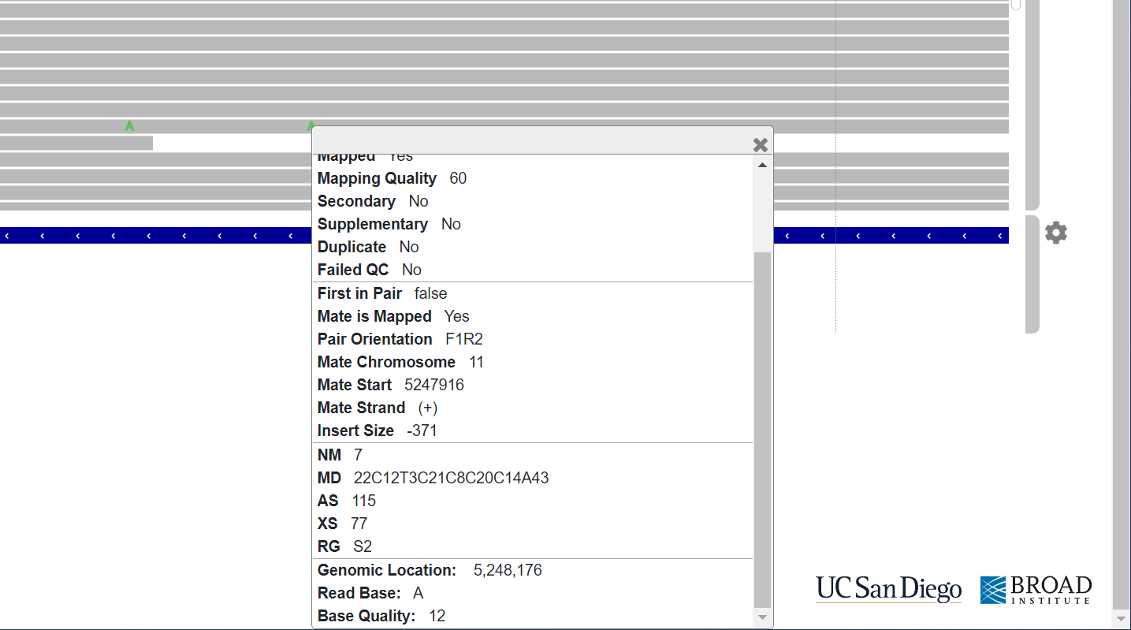
This is the only read with A here; A has low base quality; not real

Slide 21
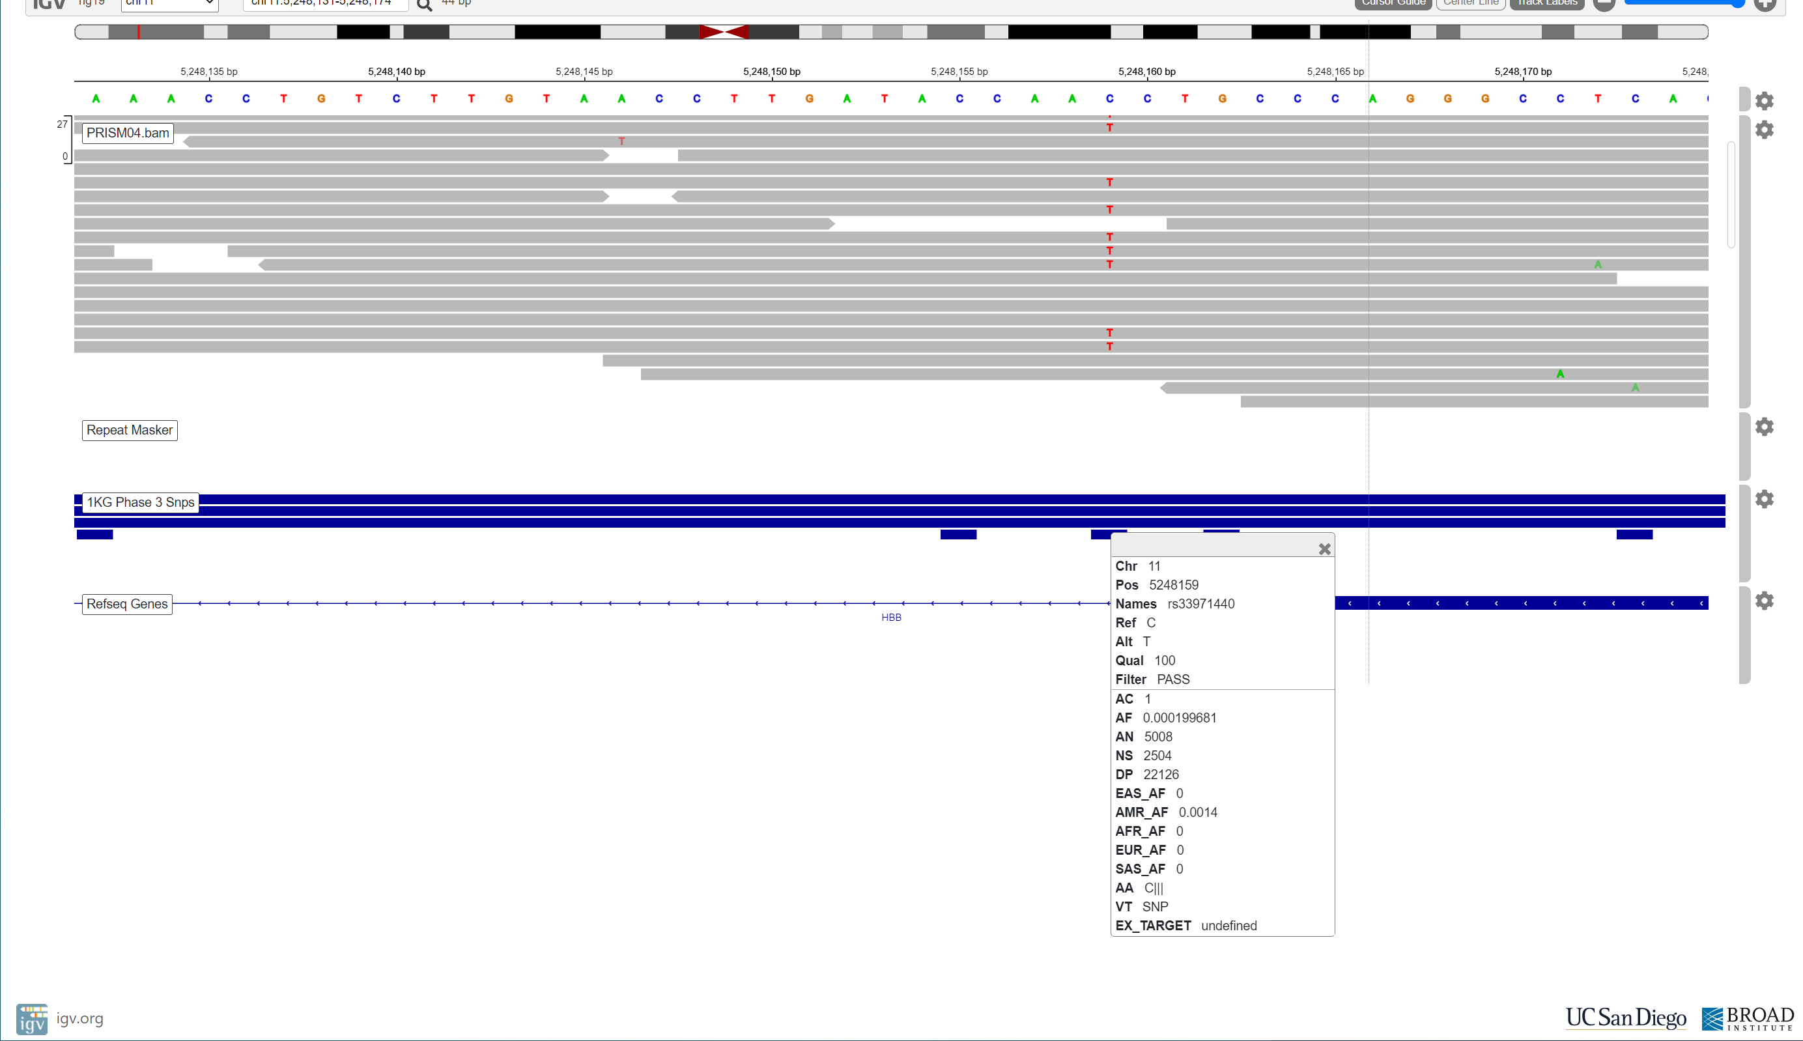

Slide 22
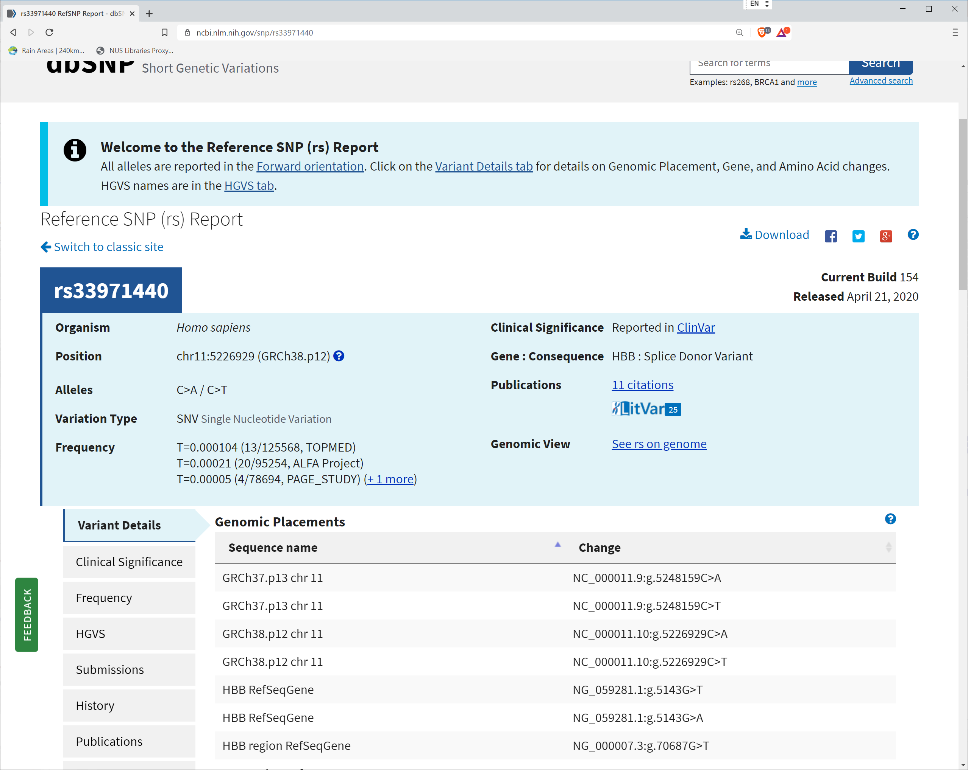

Slide 23
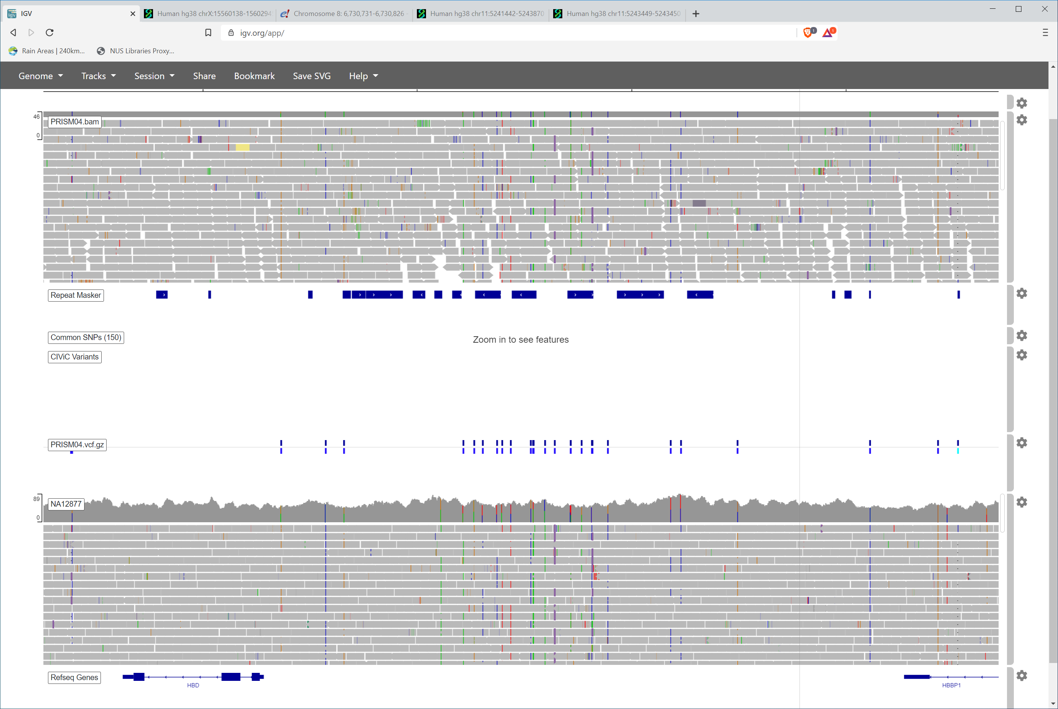

Slide 24
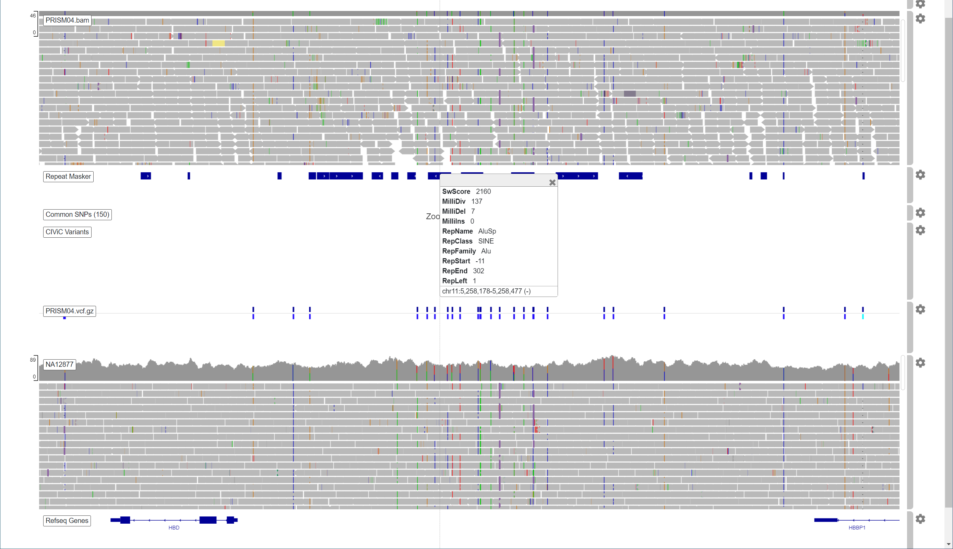

Slide 25
